Slide 1
Weeder Courses
Jennifer Be
Hannah Broido
Pui Fung Lam
Jong Ha Lee

Slide 2
Objectives and Research Question
Examine the effects of weeder courses on enrollment and dropout rates of Underrepresented Minorities (URMs) in STEM courses
Further analyze the possible causes of effects of weeder courses, especially for Underrepresented Minorities
Research Question:
What are the effects of weeder courses on proportion of ethnic groups in STEM courses and majors, and what are the potential correlational factors/causes?
Notes:
Jong

Slide 3
Preliminary Research Design
Define “weeder courses” - L&S Lower-division major prerequisites that:
1. Possesses a large class size which includes many students interested, but not declared, in pursuing a major that specifically requires completing the weeder course successfully
2. Are adequately difficult to determine whether one can successfully continue the major
3. And overall, results in many student that not only drop out from the prerequisite course, but more importantly, “drops out” from declaring a certain major itself
Sample course progressions we are interested in:
CS 61A-> 61B -> 61C
Chemistry series 1A –> 3A -> 3B
Physics 8A -> 8B
Define different “URMs” - African-American, Chicano/Latino, Native-American/Alaska Native, Pacific Islander
Notes:
Jong

Slide 4
Part 1: What is the disproportion in dropout rate between URMs as compared to other ethnic groups/overall dropout rate?
Notes:
Jong transition to Steven

Slide 5
How we are currently analyzing data for enrollment rates?
Doing a weekly progression (Week 0-17)
Analyzing the dropout rates in each group with comparison to others
How we are currently categorizing data for enrollment rates:
Overall
Male Non-URMs
URMs
Female
Female URMs
Non-URMs: Asian, Decline to State, International, White
URMs: African American, Chicano/Latino, Native American/Alaska Native, Pacific Islander
Notes:
Steven

Slide 6
Classes Analyzed
Chemistry 1A → 3A → 3B
Physics 8A → 8B
Biology 1A
Computer Science 61A → 61B → 61C
Control Non-Weeder Courses:
Engineering 7
Engineering 25
International & Area Studies 45
Notes:
Steven

Slide 7
Chemistry Series

Slide 8
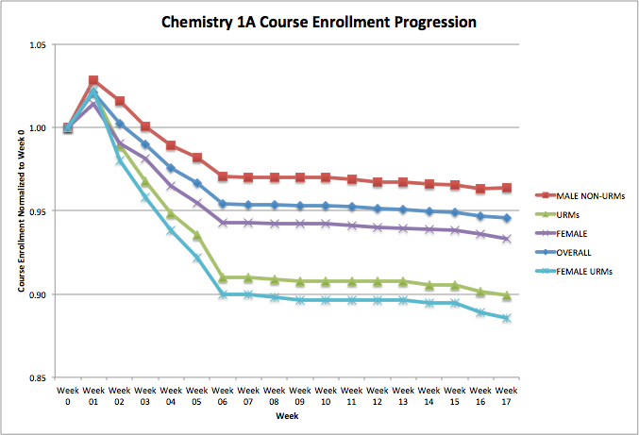
Notes:
Hannah

Slide 9
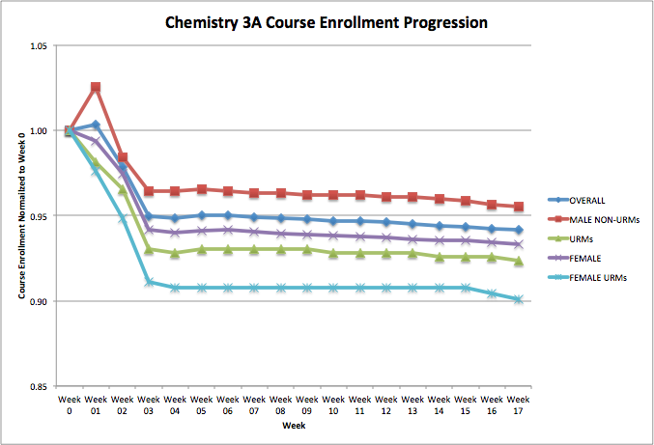
Notes:
Hannah

Slide 10
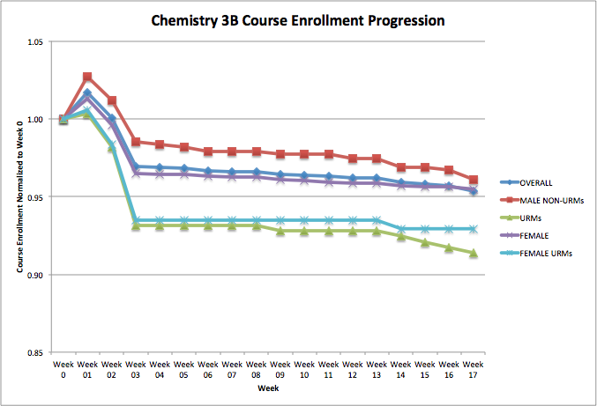
Notes:
Hannah

Slide 11
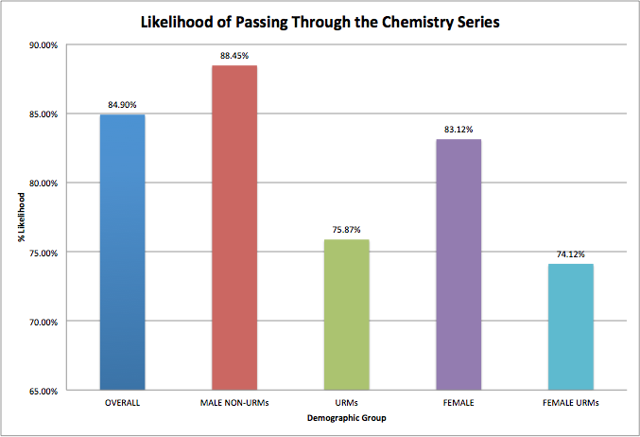
Notes:
Hannah

Slide 12
Analysis for Chemistry Series
Our analysis show that URMs and Female URMs have the highest dropout rates throughout the Chemistry series
It further proves our definition of weeder courses as the patterns do not occur in our control group
I highly doubt that it is just a coincidence with our selected courses
For long term effects, this results in less URMs declaring a major in the STEM field.
Notes:
Hannah

Slide 13
Computer Science Series
Notes:
Steven

Slide 14
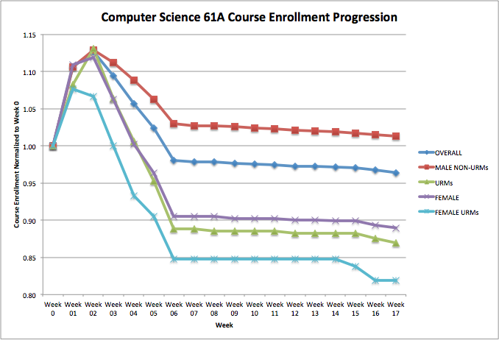
Notes:
Steven

Slide 15
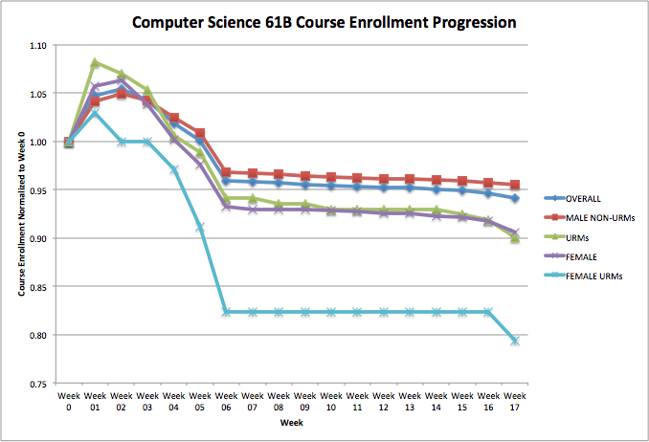
Notes:
Steven

Slide 16
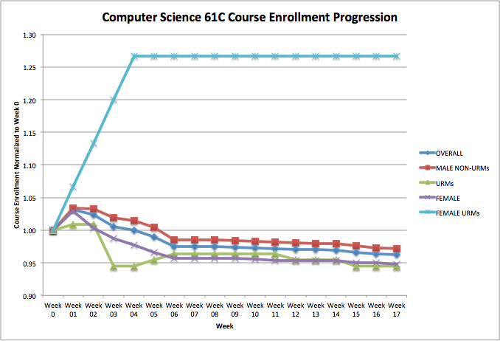
Notes:
Steven
-Note that sample size of Female URMs only had <20 thus resulting in inaccurate data
-There is a pipeline effect that at the end of the series which made the sample size smaller

Slide 17
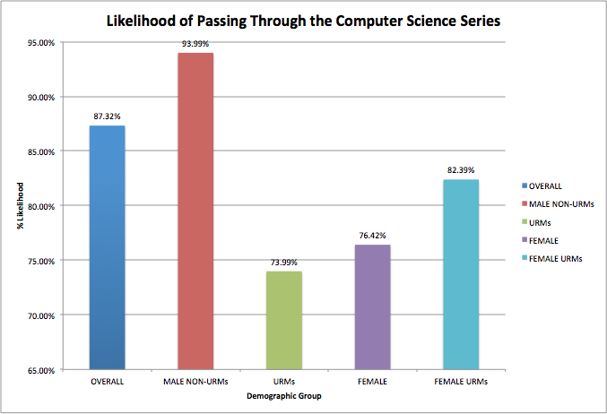
Notes:
Steven
Female URMs likelihood probability greatly impacted by CS61C increase

Slide 18
Physics Series
Notes:
Hannah

Slide 19
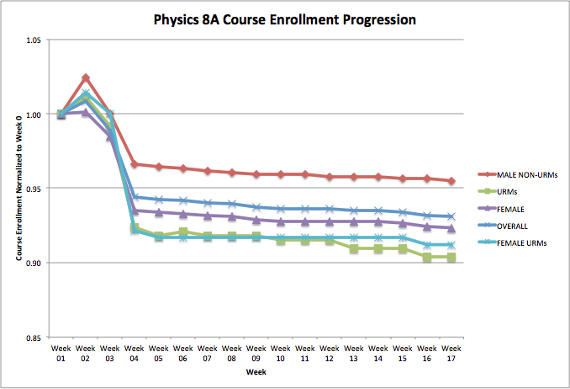
Notes:
Hannah

Slide 20
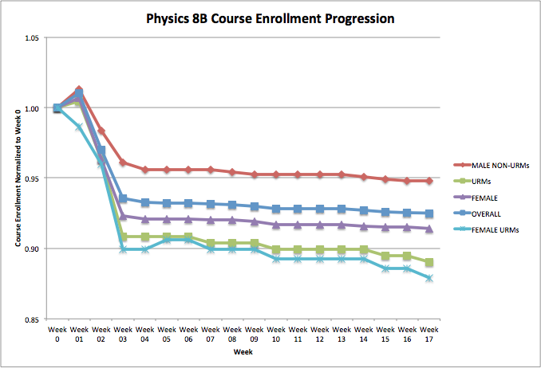
Notes:
Hannah

Slide 21
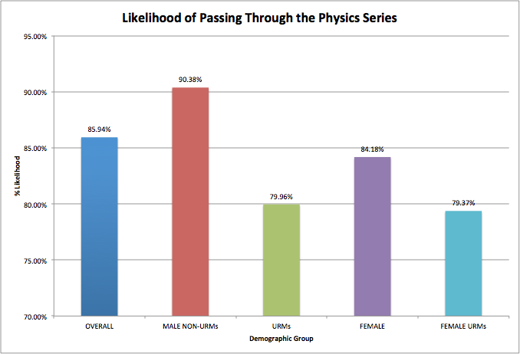
Notes:
Hannah

Slide 22
Biology

Slide 23
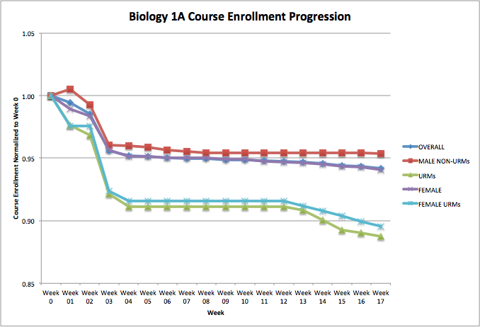
Notes:
Jennifer

Slide 24
Control: Non-Weeder Courses

Slide 25
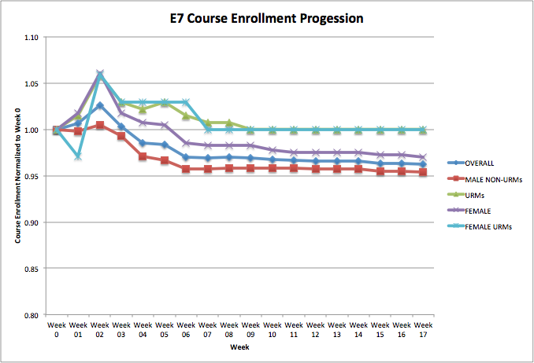
Notes:
Jennifer
Male Non-URMs has the highest dropout rate

Slide 26
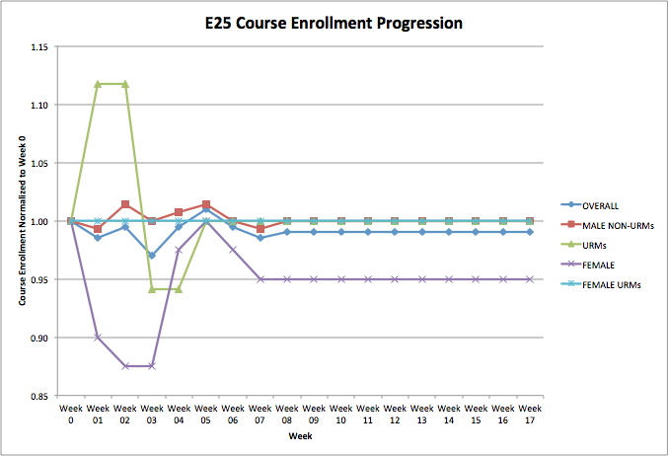
Notes:
Jennifer

Slide 27
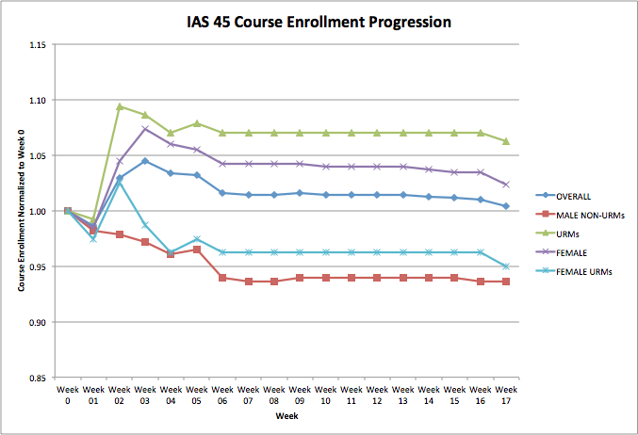
Notes:
Hannah
Male Non-URMs has the highest dropout rate

Slide 28
Control Courses Analysis
URMs and Female URMS do not follow the same pattern in control courses than weeder courses.
In these courses, they have the exact opposite phenomena.
Possible explanation for this effect:
“Courses that have very low average grades on exams can differentially discourage the latter group of students from continuing in STEM majors.” (“Engage to Excel”)
Notes:
Hannah

Slide 29
Part 2: What are potential factors that contribute to the disproportion of dropout rates in introductory STEM courses?
Notes:
Hannah

Slide 30
Proposed Method: Snowball Interviews
Gain individual accounts and experiences with introductory STEM courses through in-depth, in-person interviews
Interviewed both URMs and non-URMs who took the proposed “Weeder” STEM courses for comparison
Asked for referrals for students who have had similar dropout experiences in introductory STEM courses (“snowballing” interviewees)
Notes:
Jennifer

Slide 31
Common Dropout Reasons for URM Interviewees
The innate difference in background and resources
Well-off background of majority groups vs. underprivileged background of minority groups, and the lack of support for the latter especially in STEM courses
Lack of representation for minorities
Includes both being unaware of the other fellow minority groups present in the class, and simply not having enough minorities in STEM courses
According to a recent Daily Californian article, “UC Berkeley’s faculty diversity falls well behind the relative diversity of California’s population, and recent campus reports show that it also lags behind diversity in the academic job market.”
Sheer difficulty of the course
Dropouts not only due to midterm scores, but also the speed and quantity of content covered in introductory STEM courses
Traditional lecture courses are typically packed in content and are not intended to actively engage students
Notes:
Jong
http://www.dailycal.org/2015/07/12/uc-berkeleys-persistent-lack-of-faculty-diversity-prompts-efforts-to-address-issue/
Jong and Jennifer

Slide 32
Interview with Non-URM Students
Male vs. Female Non-URM Opinions Differ Greatly
Female Non-URM mentioned many aspects of “lack of empowerment” and “underrepresentation” in the STEM course she took
In contrast, male non-URM voiced concerns on time management and exploring different options, not necessarily experiencing difficulties in support groups, representation, etc.
Understands the lack of representation of URM students
Clearly comprehends the sheer lack of representation of URM students from the start, for students who are taking the weeder course, GSI’s, study groups, etc
At the same time, voiced concerns on whether preexisting, majority study groups will “fit” the needs of minorities
Notes:
Jennifer

Slide 33
Professor Perceptions
Weeder courses must have intent of weeding out students
URM students do not utilize resources such as office hours and student learning center
Attributed it to high school experiences - having the experience and confidence to utilize resources
Students are used to getting A’s in high school and may therefore be dropping out as they consider Bs and Cs to be bad grades
Course GSIs rarely URMs
Notes:
Hannah

Slide 34
Proposed Solutions from URM Interviewees
Mini-introductory STEM courses
Especially for those coming from an under-educated background who have had little or no exposure to the difficulty of introductory STEM courses at Berkeley
Example: Chemistry P offered by the Student Learning Center (SLC)
A well-developed resource on finding fellow URMs in STEM courses
Mentors who have already took the course, fellow students in the course, etc
Ability test in weeder courses to assign discussion sections
Increased diversity amongst GSIs / course TAs
Which lead us to question:
Are these resources/solutions available? Are they made aware? Why do we constantly see this problem of “lack of resources”?
Notes:
Jong

Slide 35
Further Discussion of Weeder Courses
Differences on Definition and Perception of Weeder Courses
Students - all have similar definition in being difficult to test whether you will be able to move up the course progressions and declare the major
Professor - a hard course but not intended to drop anyone
Problems Addressable in the University?
Some problems, especially with the lack of resources and education minorities experience in their high school backgrounds, is difficult to change
Are the problems minorities face with STEM courses attributed to their predisposed backgrounds, lack of support from the University, or both?
There are a few programs targeted toward minority students, but to what extent are they effective? How can we scale them?
Notes:
Jennifer

Slide 36
Assumptions and Limitations
Exclusion of many College of Engineering courses from “Weeder”
Students are accepted into a particular college - e.g. into College of Engineering vs. College of Letters and Sciences
Very difficult to switch into College of Engineering, where students have already technically have “declared” their majors
College of Engineering likely to have already ‘weeded’ out high school seniors from minority groups
Dropout after drop deadline
Possibly due to other confounding factors besides the weeder course itself
Relative proportions vs. absolute number of students
Overall (1000+ students) vs. URMs (30 students) and the effects on enrollment rate per student drop
Notes:
Steven

Slide 37
Assumptions and Limitations (cont.)
Week 0 Normalization
Inaccurate/inconsistent data trends due to the assumption that Week 0 is the “start” of course progression, even though class does not begin then
Small Sample Size of Interviews
Since it is a snowball interview method, may not be representative of the URM population
Potential Further Analysis
Lack of support vs. lack of awareness vs. lack of initiative?
Exploring multiple possible solutions and experimenting them
Notes:
Steven

Slide 38
Conclusion
Data analysis demonstrated the disproportion of retention rates in individual STEM courses, and STEM major course progressions
Trend was consistent throughout the biggest “weeder” courses at UC Berkeley, which led to in-person interviews to discover potential causes
Snowball interviews gave us insights to different opinions, from URMs to non-URMs to Professors
Next steps may entail experimenting potential solutions, and delving further into where exactly the problem lies: awareness, support, or initiative?
Notes:
Jong

Slide 39
Citations
Chang, M. J., Sharkness, J., Hurtado, S., & Newman, C. B. (2014). What matters in college for retaining aspiring
scientists and engineers from underrepresented racial groups. Journal Of Research In Science Teaching,
51(5), 555-580. doi:10.1002/tea.21146
Olson, S., Riordan, D. G., & Executive Office of the, P. (2012). Engage to Excel: Producing One Million Additional
College Graduates with Degrees in Science, Technology, Engineering, and Mathematics. Report to the
President. Executive Office Of The President,
Pauker, Madeleine. "UC Berkeley’s persistent lack of faculty diversity prompts efforts to address issue." The Daily
Californian. The Independent Berkeley Student Publishing Co., 12 Jul. 2015. Web. 28 Nov. 2015.

